Slide 1
Domain Specific Languages + Industrial Platform Constraints
Subject Name: Platform Based Development
Subject Code: PBDE401 | PBDV301
Lecturer Name : Freedom
Department : Information Technology

Slide 2
Outline of the lesson
Objectives
Define Domain-Specific Languages (DSLs) and their role in robotics
Describe key characteristics of DSLs
Classify DSLs and explain their benefits and use cases
Explain Visual Programming Languages (VPLs) as a form of DSL in robotics
Identify challenges associated with using DSLs
Recognize industrial platform constraints that affect DSL implementation

Slide 3
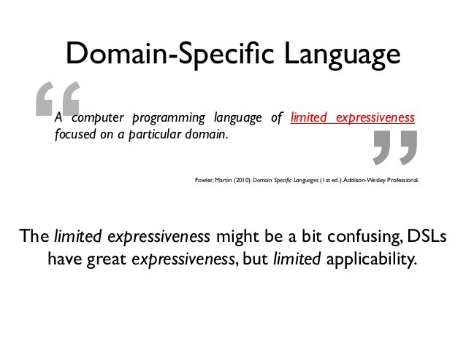
Domain Specific Language (DSL)

Slide 4

Domain Specific Language
Domain-Specific Language (DSL) is a programming language specifically designed to address the requirements and constraints of a particular domain or problem space.
DSLs enable domain experts to write code and express concepts in a way that closely aligns with their domain-specific knowledge and terminology.
They provide tailored commands and syntax to make robot development more intuitive
In robotics, DSLs are used to control robot behavior, movement, or communication.
Examples: ABB RAPID for industrial robots, VEXcode for educational robotics

Slide 5
Types of Domain Specific Languages
External DSL
    An external DSL has its own syntax and is parsed by a separate compiler or interpreter. Examples include SQL (for database queries) and regular expressions.
Internal DSL (Embedded DSL)
    An internal DSL is embedded within a host programming language. It leverages the syntax and constructs of the host language, making it easier to integrate with existing codebases. Examples include Ruby on Rails (for web development) and SwiftUI (for iOS app development).
    Use a base language, such as Lisp, F# or Haskell

Slide 6
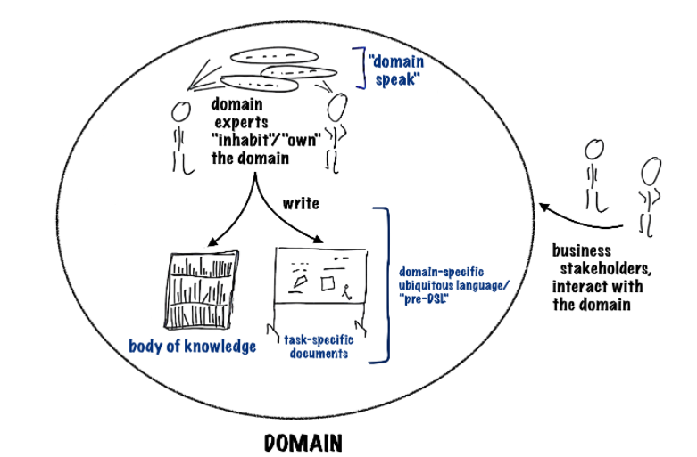
Domain Specific Language
Characteristics of DSLs
  High-level of abstraction-Hides technical complexity; uses familiar domain terms.
  Domain Focus- Designed for specific tasks (not general-purpose)
  Limited Scope- Powerful within the domain, but not useful outside it.
  Readability - Easier for non-programmers or engineers
  Productivity

Slide 7
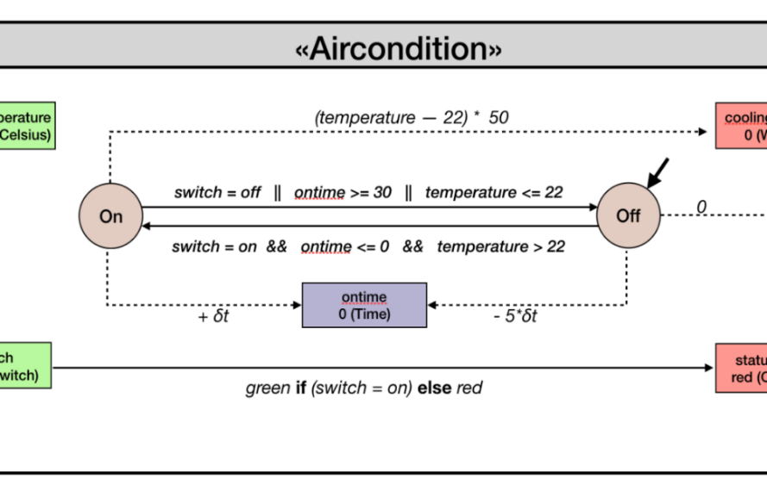
Domain Specific Languages
DSLs can be classified based on their purpose and the problem domain they address
  Text-based DSLs - are programming languages designed to address specific domains using textual representations.
  Behavioural DSLs - focus on capturing and representing the behaviour or logic of systems or components within a specific domain. These DSLs enable users to describe the expected behaviour, rules, and interactions of entities within a system.
  Motion Control DSLs - are designed specifically for controlling and orchestrating the movement of physical objects or devices, such as robots, drones, or industrial machinery.
  Simulation DSLs - are used to model and simulate real-world phenomena or systems in a specific domain. These DSLs provide constructs and abstractions to define the entities, properties, and behaviors of the system being simulated.

Slide 8
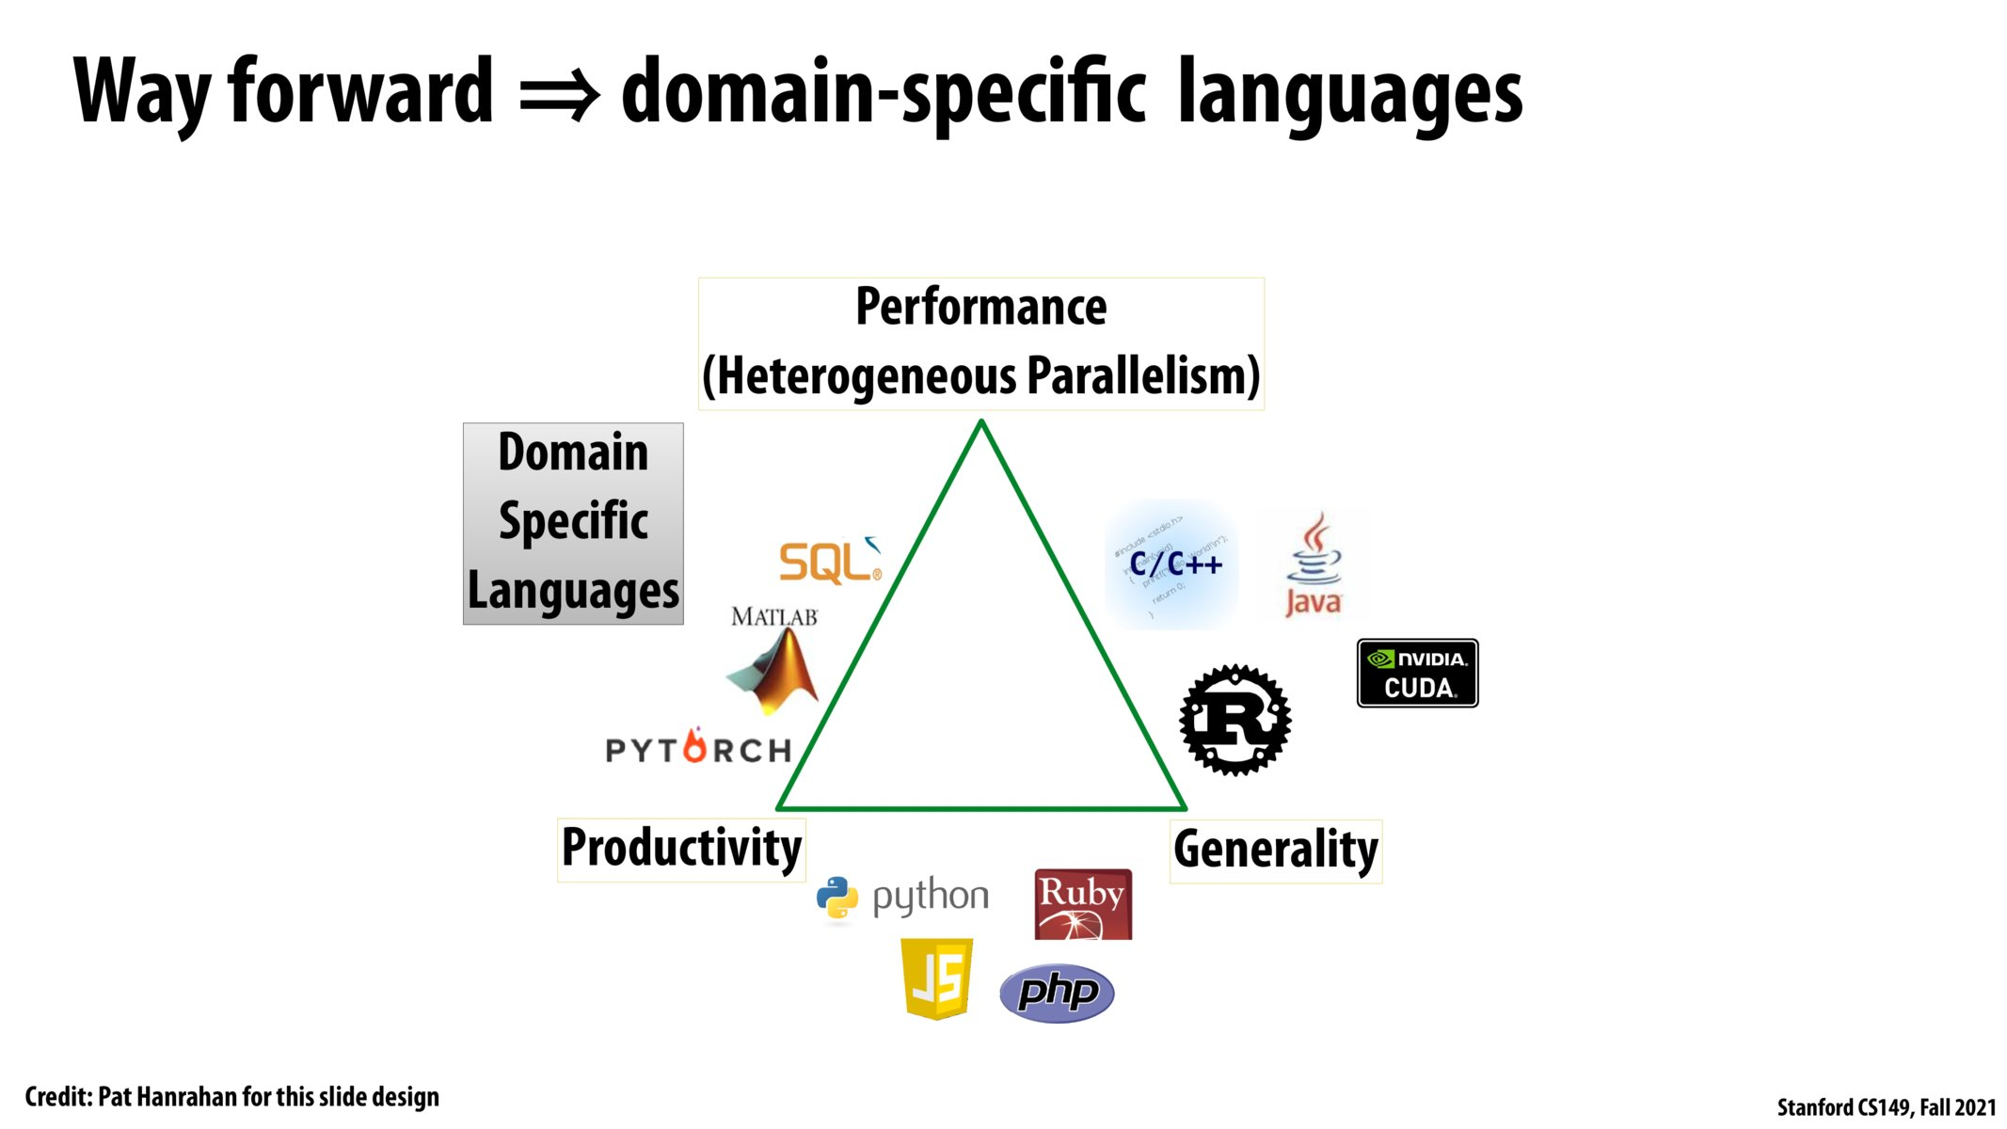
Domain Specific Languages
Use Cases for DSLs
  Database Query Languages (e.g., SQL): DSLs tailored for querying and manipulating database data.
  Configuration Languages (e.g., YAML, JSON): DSLs for specifying configuration settings in a structured manner.
  Scientific and Mathematical Modeling (e.g., MATLAB): DSLs that facilitate expressing mathematical and scientific concepts.
  Game Development (e.g., Unreal Engine Blueprints): DSLs for designing game mechanics and behaviors without traditional coding.

Slide 9
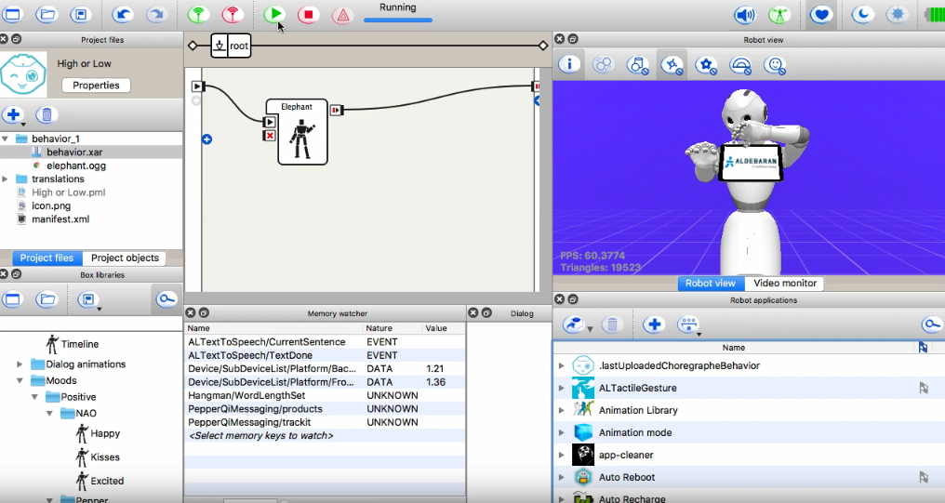
Visual Programming Languages in Robotics
Visual Programming Languages (VPLs) are indeed a common form of DSL used in robotics.
  VPLs allow users to create and manipulate programs using graphical elements and visual representations instead of traditional textual code.
  They have been used to program social robots (Interaction Composer), IoT devices and robots (Robokol) and service robots.
  They offer a better visualization and understanding of both the modeling process and the final model.

Slide 10
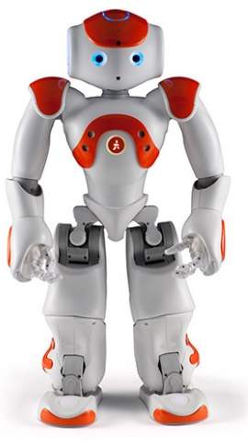
DSL – VPL & Textual Representation
DSL that combine of VPL and textual representations :
Choregraphe - programs a Nao robot
LightRocks - allows defines models for production robots
DiaSpec - allows defining Sence/Compute/Control applications
Sumsumption - defines models of a complete robotic system.

Slide 11
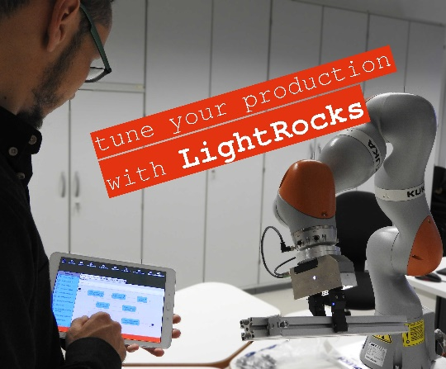
Challenges of DSL
Learning Curve- Developers need to learn the specific syntax, semantics, and constructs of the DSL, which can have a learning curve.
Limited Community and Tools- DSLs may have a smaller community compared to general-purpose languages, resulting in fewer resources and tools available.
Integration with General-Purpose Code- When using an external DSL, integration with general-purpose code may require additional effort and coordination.

Slide 12
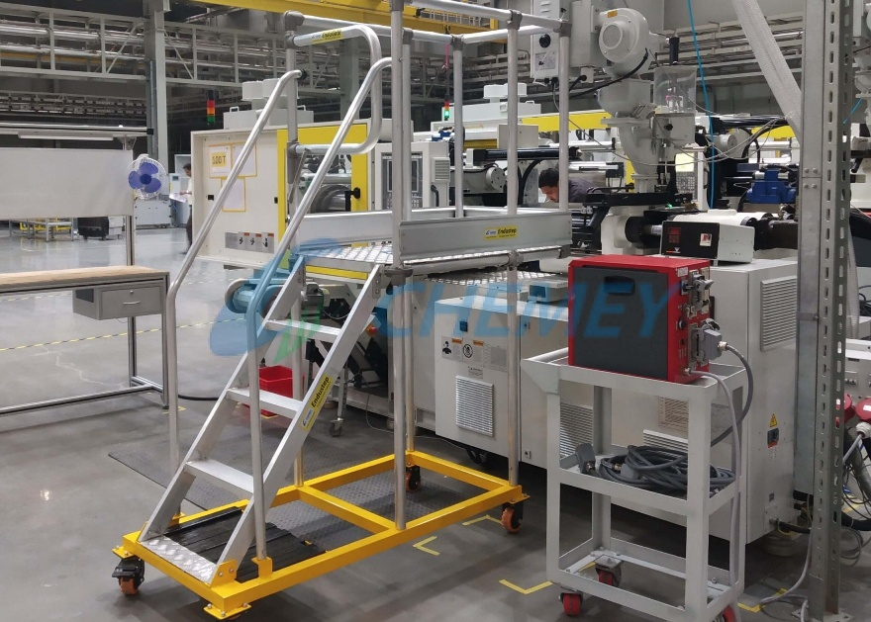
Industrial Platform Constraints (IPCs)
Real-Time Performance
Limited Processing Power and Memory
Hardware Specificity/ Vendor Lock-In
Legacy System Compatibility
Safety and Regulatory Compliance
Scalability and Maintainability
Cybersecurity
Connectivity and Communication Protocols
Power and Energy Efficiency
Cost Constraints and ROI Requirements

Slide 13

DSLs on IPC
DSLs must compile or interpret to real-time-capable code for motion control and sensor feedback.
DSLs must be lightweight, efficient, and avoid overhead-heavy features.
DSLs often become tied to a vendor (e.g., FANUC KAREL, KUKA KRL), reducing portability across platforms.
DSLs need integration capabilities with older systems using industrial protocols like OPC UA or Modbus.
DSLs must avoid vulnerable constructs and be compatible with secure runtime environments.
DSLs should be modular, well-documented, and easy to update over time, especially by engineers.
DSLs must enable or support interfacing with PLCs, sensors, and actuators.

